Slide 1
We All Live in a Watershed!
2016 Alexander SWCD Contest Season
Poster, Essay, and Speech

Slide 2
SWCD POSTER CONTEST: We All Live in a Watershed!
Specifications:
No larger than 24 x 36 in.
Width no more than 1/8 in. thick
No 3D objects mounted on poster (only 2D)
Any type of coloring materials allowed
Computer/Magazine pictures can be used- yet, MUST follow copy write laws (No recognizable cartoons) Hand drawn pictures are preferred over computer-generated drawings.
Must be the original work of the student
Should be FLAT, not ROLLED
Point Deductions:
Copyright Violation -5pts. Exceed Size Limit -5pts

Slide 3
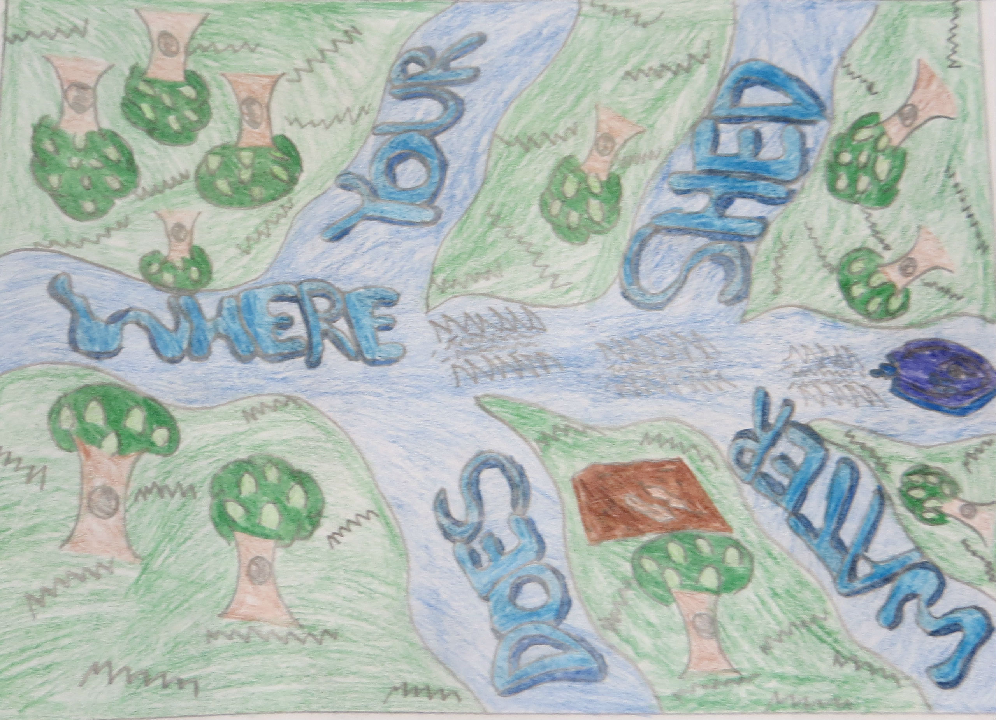
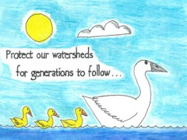
SWCD POSTER CONTEST: We All Live in a Watershed!
EXAMPLES:

Slide 4
SWCD POSTER CONTEST: We All Live in a Watershed!
Cash Awards:
District (county)– Each school submits top 3 posters
• School winner- Banquet + $20 & 1st place ribbon
• County 1st = $30 & plaque
• County 2nd = $15 & ribbon
Area (13 counties)- District winner enters Area level
• 1st = $75 & medal
• 2nd = $50 & medal
• 3rd = $25 & medal
State (8 areas)- Area winner enters State level
• 1st = $200 & plaque
• 2nd = $100 & plaque

Slide 5
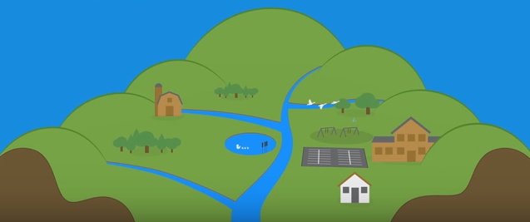
What is a Watershed?
Definition:
all of the land that drains to the same location or body of water
Click here to found out more information

Slide 6
Save the Watersheds!
We need to protect individual watersheds from:
Pollution
erosion issues
ecological damage
negative changes to typography and soils
BECAUSE:
watersheds ultimately provide us with water for:
Drinking
food production
help run our industries

Slide 7
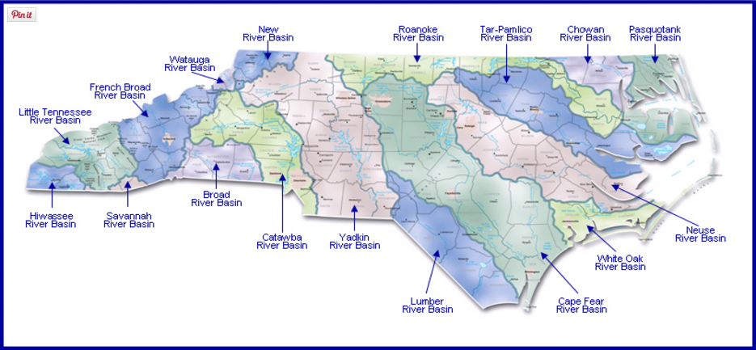
Watersheds found in NC

Slide 8
We All Live in a Watershed!
Poster contest contestants are asked to draw a picture advertising/depicting the current theme.
Posters should be submitted flat, not rolled, no larger than 24x36 inches, and should be the individual work of the student.
Judging will be based on conservation message, visual effectiveness, and originality.
We encourage a brief, catchy message/slogan that makes viewers want to take conservative action and think twice about environmental degradation.

